Slide 1
Using DDL Statements
to Create and Manage Tables
Copyright © 2009, Oracle. All rights reserved.

Slide 2
Objectives
After completing this lesson, you should be able to do the following:
Categorize the main database objects
Review the table structure
List the data types that are available for columns
Create a simple table
Explain how constraints are created at the time of table creation
Describe how schema objects work
10 - 2

Slide 3
Lesson Agenda
Database objects
Naming rules
CREATE TABLE statement:
Access another user’s tables
DEFAULT option
Data types
Overview of constraints: NOT NULL, UNIQUE, PRIMARY KEY, FOREIGN KEY, CHECK constraints
Creating a table using a subquery
ALTER TABLE
Read-only tables
DROP TABLE statement
10 - 3

Slide 4
Database Objects
Object | Description
Table | Basic unit of storage; composed of rows
View | Logically represents subsets of data from one or more tables
Sequence | Generates numeric values
Index | Improves the performance of some queries
Synonym | Gives alternative name to an object
10 - 4

Slide 5
Naming Rules
Table names and column names must:
Begin with a letter
Be 1–30 characters long
Contain only A–Z, a–z, 0–9, _, $, and #
Not duplicate the name of another object owned by the same user
Not be an Oracle server–reserved word
10 - 5

Slide 6
Lesson Agenda
Database objects
Naming rules
CREATE TABLE statement:
Access another user’s tables
DEFAULT option
Data types
Overview of constraints: NOT NULL, UNIQUE, PRIMARY KEY, FOREIGN KEY, CHECK constraints
Creating a table using a subquery
ALTER TABLE
Read-only tables
DROP TABLE statement
10 - 6

Slide 7

CREATE TABLE Statement
You must have:
The CREATE TABLE privilege
A storage area
CREATE TABLE [schema.]table
(column datatype [DEFAULT expr][, ...]);
You specify:
The table name
The column name, column data type, and column size
10 - 7

Slide 8

Referencing Another User’s Tables
Tables belonging to other users are not in the user’s schema.
You should use the owner’s name as a prefix to those tables.
USERA SELECT *
FROM userB.employees;
USERB SELECT *
FROM userA.employees;
10 - 8

Slide 9
DEFAULT Option
Specify a default value for a column during an insert.
... hire_date DATE DEFAULT SYSDATE, ...
Literal values, expressions, or SQL functions are legal values.
Another column’s name or a pseudocolumn are illegal values.
The default data type must match the column data type.
CREATE TABLE hire_dates
(id NUMBER(8),
hire_date DATE DEFAULT SYSDATE);
10 - 9

Slide 10
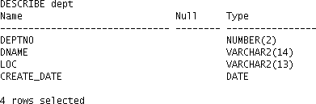
Creating Tables
Create the table:
CREATE TABLE dept
(deptno
dname loc
NUMBER(2), VARCHAR2(14), VARCHAR2(13),
create_date DATE DEFAULT SYSDATE);
Confirm table creation:
DESCRIBE dept

Slide 11
Lesson Agenda
Database objects
Naming rules
CREATE TABLE statement:
Access another user’s tables
DEFAULT option
Data types
Overview of constraints: NOT NULL, UNIQUE, PRIMARY KEY, FOREIGN KEY, CHECK constraints
Creating a table using a subquery
ALTER TABLE
Read-only tables
DROP TABLE statement

Slide 12
Data Types
Data Type | Description
VARCHAR2(size) | Variable-length character data
CHAR(size) | Fixed-length character data
NUMBER(p,s) | Variable-length numeric data
DATE | Date and time values
LONG | Variable-length character data (up to 2 GB)
CLOB | Character data (up to 4 GB)
RAW and LONG RAW | Raw binary data
BLOB | Binary data (up to 4 GB)
BFILE | Binary data stored in an external file (up to 4 GB)
ROWID | A base-64 number system representing the unique address of a row in its table

Slide 13

Datetime Data Types
You can use several datetime data types:
Data Type | Description
TIMESTAMP | Date with fractional seconds
INTERVAL YEAR TO MONTH | Stored as an interval of years and months
INTERVAL DAY TO SECOND | Stored as an interval of days, hours, minutes, and seconds

Slide 14
Lesson Agenda
Database objects
Naming rules
CREATE TABLE statement:
Access another user’s tables
DEFAULT option
Data types
Overview of constraints: NOT NULL, UNIQUE, PRIMARY KEY, FOREIGN KEY, CHECK constraints
Creating a table using a subquery
ALTER TABLE
Read-only tables
DROP TABLE statement

Slide 15

Including Constraints
Constraints enforce rules at the table level.
Constraints prevent the deletion of a table if there are dependencies.
The following constraint types are valid:
NOT NULL
UNIQUE
PRIMARY KEY
FOREIGN KEY
CHECK

Slide 16
Constraint Guidelines
You can name a constraint, or the Oracle server generates a name by using the SYS_Cn format.
Create a constraint at either of the following times:
At the same time as the creation of the table
After the creation of the table
Define a constraint at the column or table level.
View a constraint in the data dictionary.

Slide 17
Defining Constraints
Syntax:
CREATE TABLE [schema.]table
(column datatype [DEFAULT expr] [column_constraint],
...
[table_constraint][,...]);
Column-level constraint syntax:
column [CONSTRAINT constraint_name] constraint_type,
Table-level constraint syntax:
column,...
[CONSTRAINT constraint_name] constraint_type
(column, ...),

Slide 18
Defining Constraints
Example of a column-level constraint:
CREATE TABLE employees( employee_id NUMBER(6)
CONSTRAINT emp_emp_id_pk PRIMARY KEY,
1
first_name VARCHAR2(20),
...);
Example of a table-level constraint:
CREATE TABLE employees(
employee_id first_name
...
job_id
NUMBER(6), VARCHAR2(20),
2
VARCHAR2(10) NOT NULL,
CONSTRAINT emp_emp_id_pk PRIMARY KEY (EMPLOYEE_ID));

Slide 19
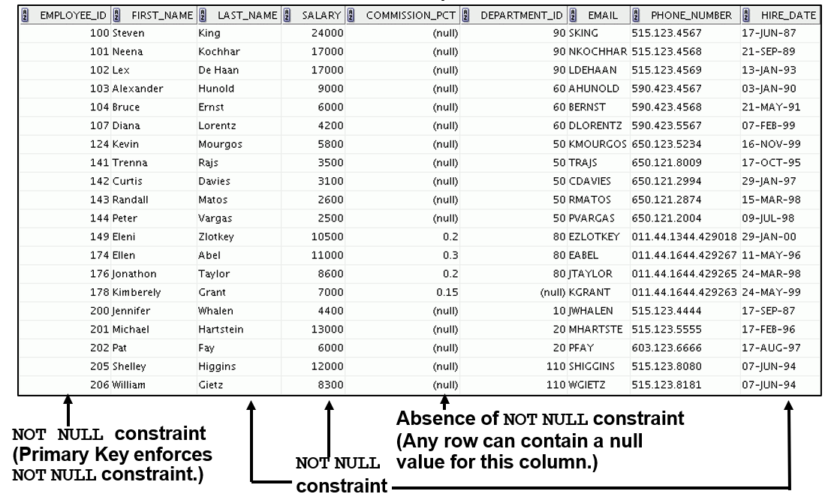
NOT NULL Constraint
Ensures that null values are not permitted for the column:

Slide 20
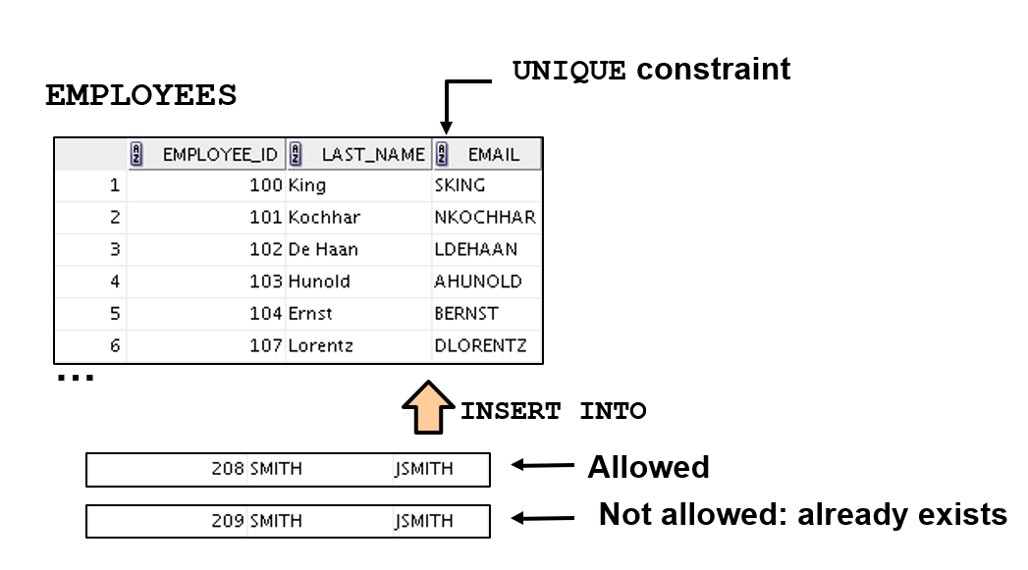
UNIQUE Constraint

Slide 21
UNIQUE Constraint
Defined at either the table level or the column level:
CREATE TABLE employees(
employee_id last_name email salary
commission_pct hire_date
NUMBER(6), VARCHAR2(25) NOT NULL, VARCHAR2(25), NUMBER(8,2),
NUMBER(2,2), DATE NOT NULL,
...
CONSTRAINT emp_email_uk UNIQUE(email));

Slide 22
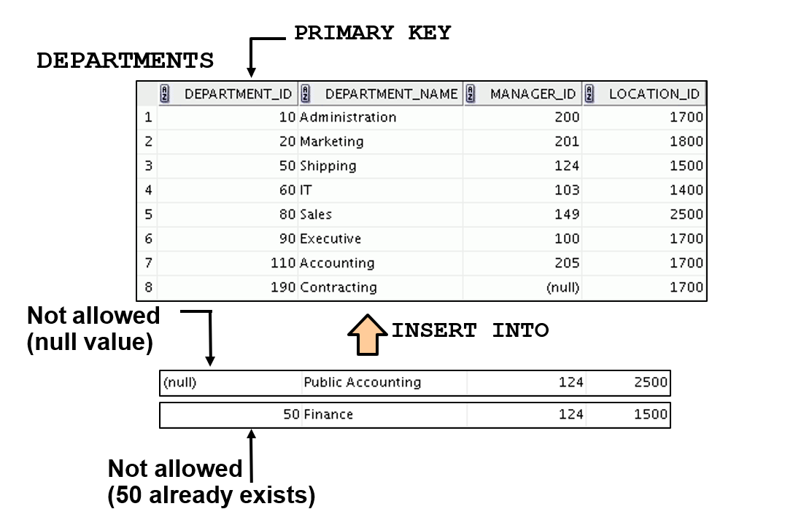
PRIMARY KEY Constraint

Slide 23
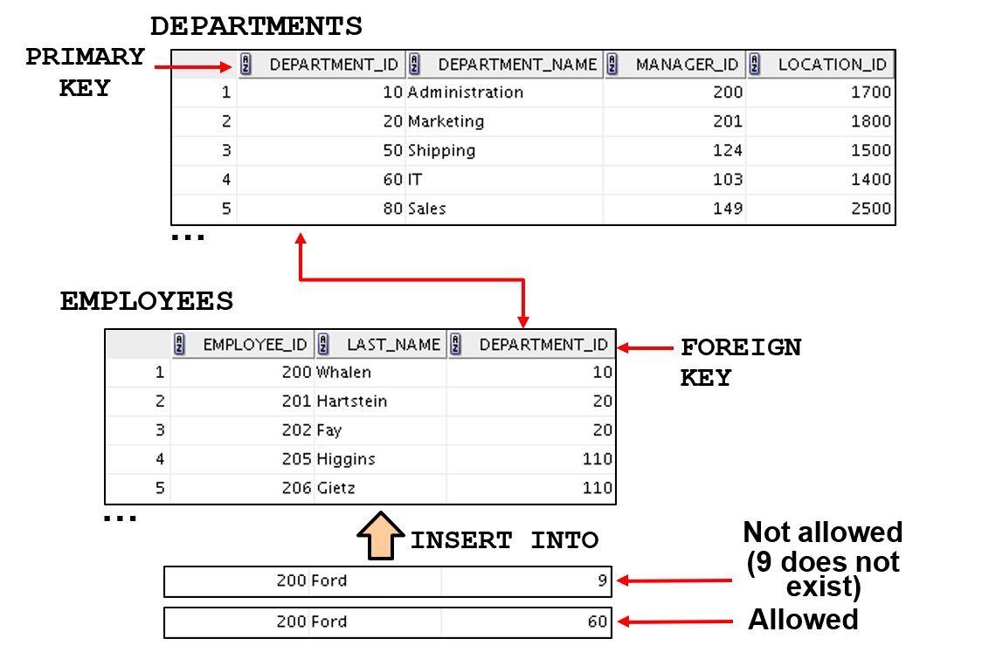
FOREIGN KEY Constraint

Slide 24
FOREIGN KEY Constraint
Defined at either the table level or the column level:
CREATE TABLE employees(
employee_id last_name email salary
commission_pct hire_date
NUMBER(6), VARCHAR2(25) NOT NULL, VARCHAR2(25), NUMBER(8,2),
NUMBER(2,2), DATE NOT NULL,
...
department_id NUMBER(4),
CONSTRAINT emp_dept_fk FOREIGN KEY (department_id) REFERENCES departments(department_id),
CONSTRAINT emp_email_uk UNIQUE(email));

Slide 25
FOREIGN KEY Constraint: Keywords
FOREIGN KEY: Defines the column in the child table at the table-constraint level
REFERENCES: Identifies the table and column in the parent table
ON DELETE CASCADE: Deletes the dependent rows in the child table when a row in the parent table is deleted
ON DELETE SET NULL: Converts dependent foreign key values to null

Slide 26
CHECK Constraint
Defines a condition that each row must satisfy
The following expressions are not allowed:
References to CURRVAL, NEXTVAL, LEVEL, and ROWNUM
pseudocolumns
Calls to SYSDATE, UID, USER, and USERENV functions
Queries that refer to other values in other rows
..., salary NUMBER(2) CONSTRAINT emp_salary_min
CHECK (salary > 0),...

Slide 27
CREATE TABLE: Example
CREATE TABLE employees
( employee_id
CONSTRAINT
, first_name
, last_name
CONSTRAINT
, email
CONSTRAINT CONSTRAINT
, phone_number
, hire_date
CONSTRAINT
, job_id
CONSTRAINT
, salary
CONSTRAINT
NUMBER(6)
emp_employee_id VARCHAR2(20) VARCHAR2(25)
emp_last_name_nn VARCHAR2(25)
emp_email_nn emp_email_uk
VARCHAR2(20)
PRIMARY KEY
NOT NULL
NOT NULL UNIQUE
DATE
emp_hire_date_nn VARCHAR2(10)
emp_job_nn NUMBER(8,2)
emp_salary_ck
NOT NULL
NOT NULL
CHECK (salary>0)
, commission_pct NUMBER(2,2)
, manager_id NUMBER(6)
CONSTRAINT emp_manager_fk REFERENCES employees (employee_id)
, department_id CONSTRAINT
NUMBER(4)
emp_dept_fk REFERENCES
departments (department_id));

Slide 28
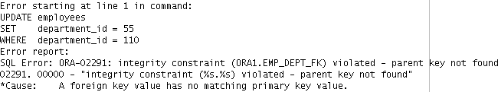
Violating Constraints
UPDATE employees
SET department_id = 55 WHERE department_id = 110;
Department 55 does not exist.

Slide 29
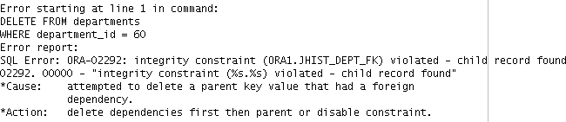
Violating Constraints
You cannot delete a row that contains a primary key that is used as a foreign key in another table.
DELETE FROM departments WHERE department_id = 60;

Slide 30
Lesson Agenda
Database objects
Naming rules
CREATE TABLE statement:
Access another user’s tables
DEFAULT option
Data types
Overview of constraints: NOT NULL, UNIQUE, PRIMARY KEY, FOREIGN KEY, CHECK constraints
Creating a table using a subquery
ALTER TABLE
Read-only tables
DROP TABLE statement

Slide 31
Creating a Table Using a Subquery
Create a table and insert rows by combining the CREATE TABLE statement and the AS subquery option.
CREATE TABLE table
[(column, column...)] AS subquery;
Match the number of specified columns to the number of subquery columns.
Define columns with column names and default values.

Slide 32

Creating a Table Using a Subquery
CREATE TABLE dept80 AS
SELECT
FROM WHERE
employee_id, last_name, salary*12 ANNSAL, hire_date
employees department_id = 80;
DESCRIBE dept80

Slide 33
Lesson Agenda
Database objects
Naming rules
CREATE TABLE statement:
Access another user’s tables
DEFAULT option
Data types
Overview of constraints: NOT NULL, UNIQUE, PRIMARY KEY, FOREIGN KEY, CHECK constraints
Creating a table using a subquery
ALTER TABLE
Read-only tables
DROP TABLE statement

Slide 34
ALTER TABLE Statement
Use the ALTER TABLE statement to:
Add a new column
Modify an existing column definition
Define a default value for the new column
Drop a column
Rename a column
Change table to read-only status

Slide 35
Read-Only Tables
You can use the ALTER TABLE syntax to:
Put a table into read-only mode, which prevents DDL or DML changes during table maintenance
Put the table back into read/write mode
ALTER TABLE employees READ ONLY;
-- perform table maintenance and then
-- return table back to read/write mode
ALTER TABLE employees READ WRITE;

Slide 36
Lesson Agenda
Database objects
Naming rules
CREATE TABLE statement:
Access another user’s tables
DEFAULT option
Data types
Overview of constraints: NOT NULL, UNIQUE, PRIMARY KEY, FOREIGN KEY, CHECK constraints
Creating a table using a subquery
ALTER TABLE
Read-only tables
DROP TABLE statement

Slide 37
Dropping a Table
Moves a table to the recycle bin
Removes the table and all its data entirely if the PURGE
clause is specified
Invalidates dependent objects and removes object privileges on the table
DROP TABLE dept80;

Slide 38
Quiz
You can use constraints to do the following:
Enforce rules on the data in a table whenever a row is inserted, updated, or deleted.
Prevent the deletion of a table.
Prevent the creation of a table.
Prevent the creation of data in a table.

Slide 39
Summary
In this lesson, you should have learned how to use the CREATE TABLE statement to create a table and include constraints:
Categorize the main database objects
Review the table structure
List the data types that are available for columns
Create a simple table
Explain how constraints are created at the time of table creation
Describe how schema objects work

Slide 40
Practice 10: Overview
This practice covers the following topics:
Creating new tables
Creating a new table by using the CREATE TABLE AS
syntax
Verifying that tables exist
Setting a table to read-only status
Dropping tables

